Slide 1

Creating a Scalable Network Digital Twin
ZTE AIOps
HUANG Zhuoyao

Slide 2
Motivation: What-if simulation for Autonomous Network
Network automation audit: More and more network configuration made by machine, such as self-healing, what-if simulation is needed.
Traffic optimization: Evaluating configuration for iteratively explore the performance of candidate solutions in order to find the optimal configuration.
K. Rusek, J. Suárez-Varela, A. Mestres, P. Barlet-Ros, A. Cabellos-Aparicio
SOSR ’19, April 3–4, 2019, San Jose, CA, USA

Slide 3
Challenge: Creating a scalable Network Digital Twin
Training: Samples of network from 25 to 50 nodes
Validation: Samples of network from 51 to 300 nodes
Different output distribution values between training and test

Slide 4
Solution overview
Based on RouteNet TensorFlow implementation provied by BNN
Predict queue utilizations and infer path delays with a simple post-processing as the guidelines suggest.
Initializing the states vector directly with paths and links features and zeros .
Train the RouteNet model on predicting queue utilizations, load the weights on another Routenet model with post-processing, then predicting path delays.

Slide 5
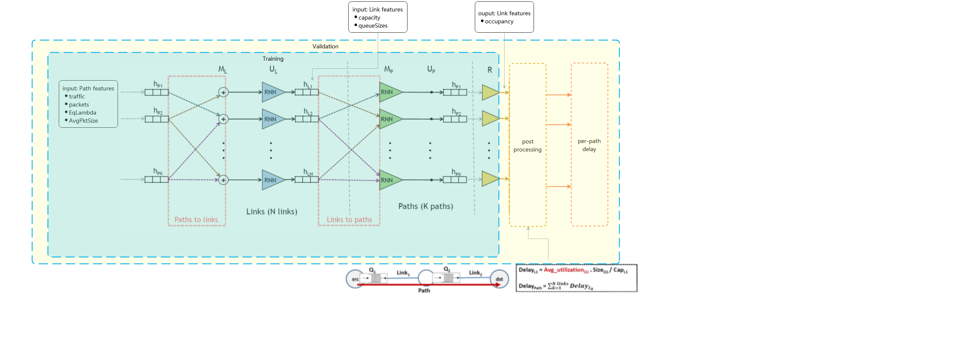
Model Architecture:
Training MAPE = 2.56
Validation MAPE = 1.85

Slide 6
Inputs and outputs
Training
inputs
link features:
capacity
queueSizes
path feautes:
traffic
packets
EqLambda
AvgPktSize
outputs
link:
occupancy
Volidation
inputs
link features:
capacity
queueSizes
path feautes:
traffic
packets
EqLambda
AvgPktSize
outputs
path:
delay

Slide 7
hyper-parameters and set up
link_state_dim:512
path_state_dim:512
t:4
readout_units:640
learning_rate:0.000003 # start with 0.001 or 0.0001, manually reducing when the MAPE reducing slow, we did it once on epoch 32.
l2: No Use
l2_2: 0.01
decay_steps:40000
decay_rate:0.6
[RUN_CONFIG]
epochs:400
steps_per_epoch:2000
validation_steps:5
Programming language: Python
ML programming framework: TensorFlow
Libraries: networkx, numpy
Training time: about 6-7 hours
GPU: NVIDIA Corporation GV100GL [Tesla V100 PCIe 32GB]

Slide 8
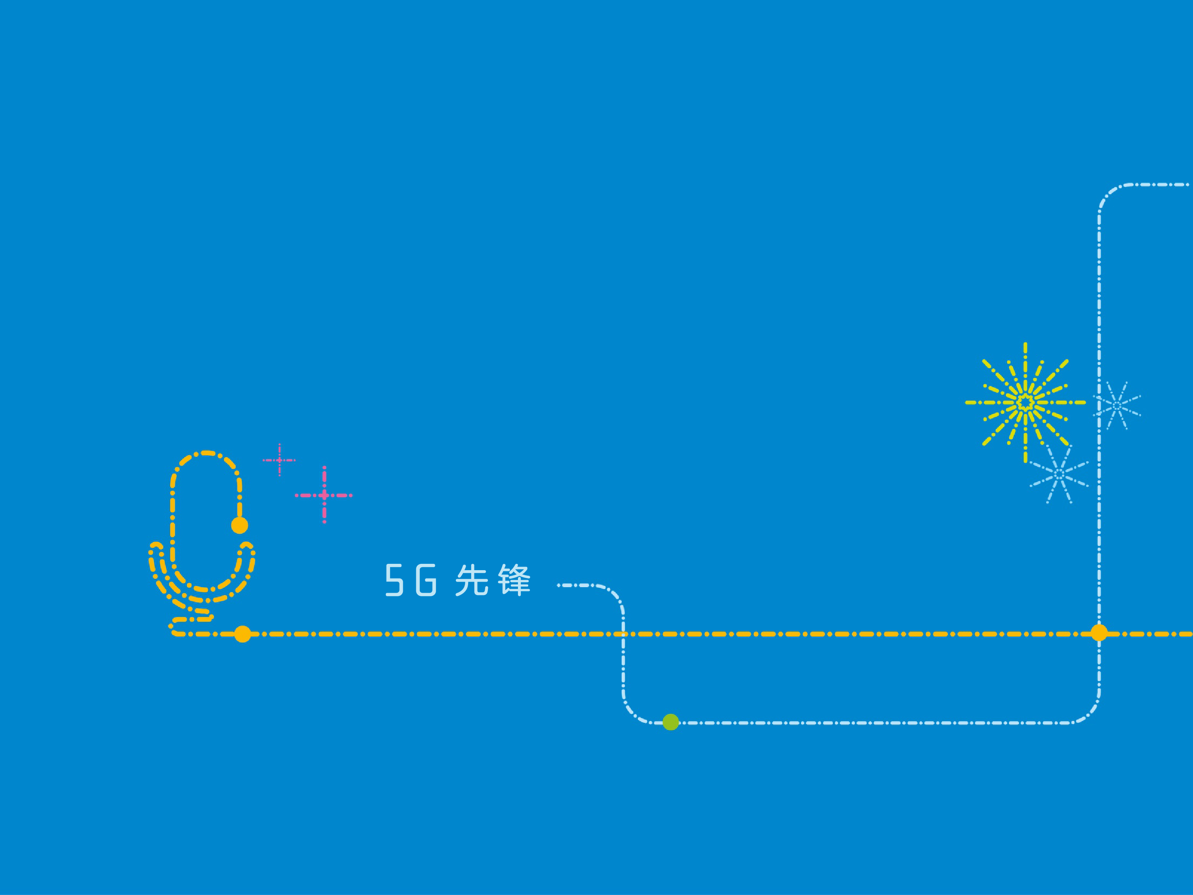
Thank you！

